Slide 1
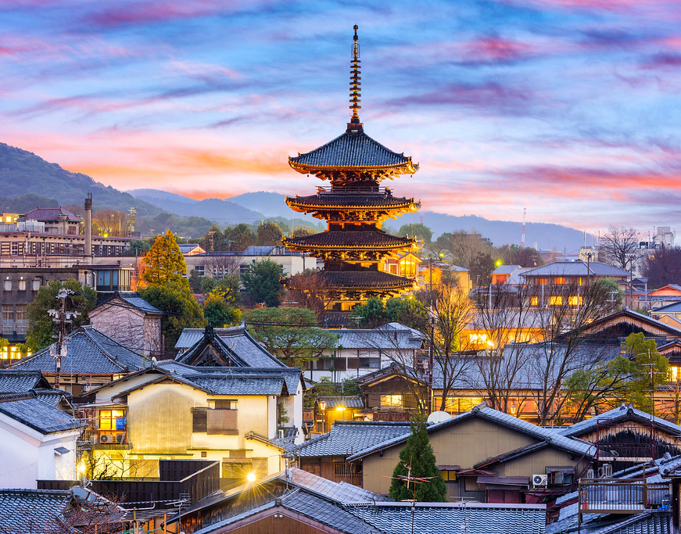
Academic
Field Trip
S.T.E.M. - Justice
February
2020

Slide 2
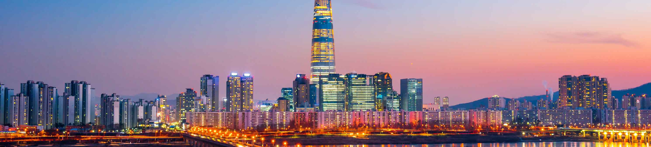
DESTINATION A – KOREA; SEOUL
The first ideal destination of the trip will be on the heart and soul of Korea.

Slide 3
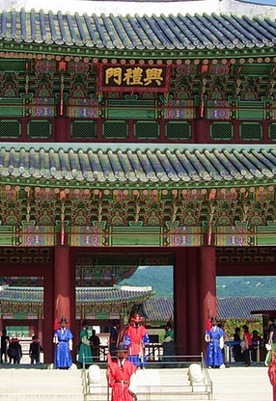
Gyeongbokgung
Palace
Museums, ornamental gardens and some of Seoul's grandest architectural sights.
A tour around Gyeongbokgung palace whilst having a tour guide explain its history and how it contributed to the culture of Korea. Also, there are a lot of other tourist attractions near the palace without having the need to use vehicles to get there.

Slide 4
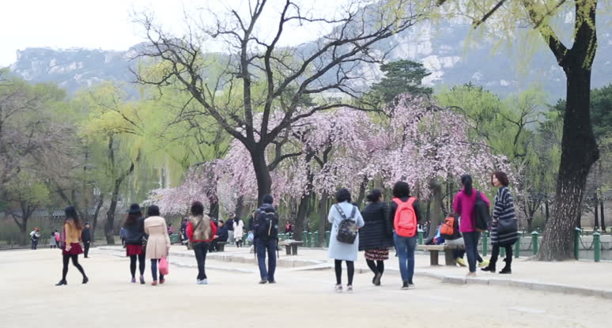
March – May
September - November
The best time period was chosen for the following reasons:
When the weather is mild, with a daily average of high temperatures staying below 70* C
The Travel Expenses are low

Slide 5
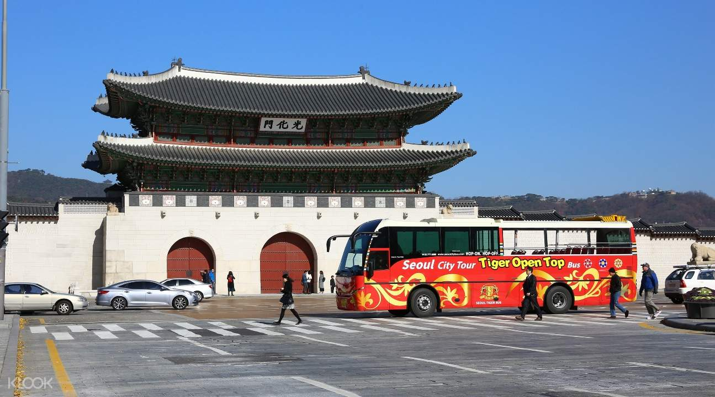
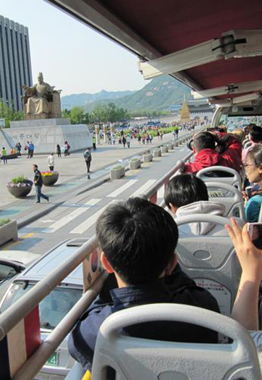
Transportation; BUS
The mode of transport will be a bus, to accompany a whole class per shuttle

Slide 6
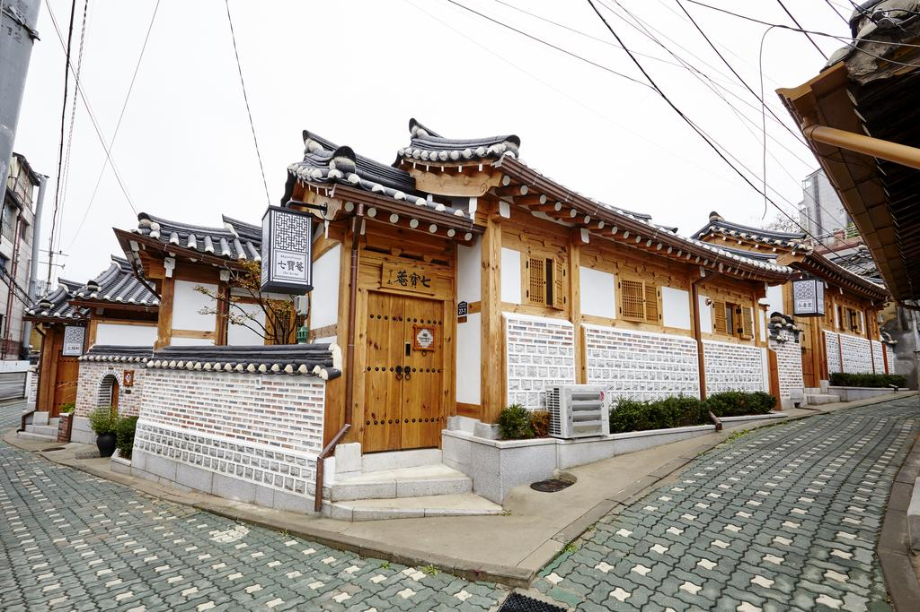
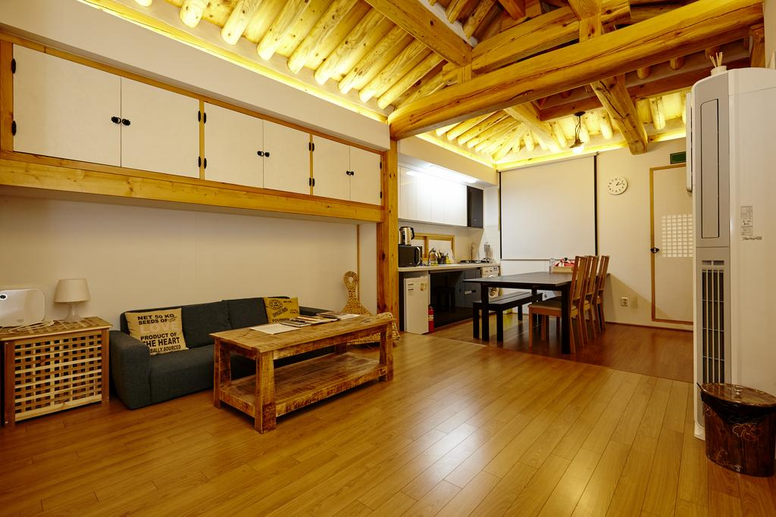
ACCOMODATION
There is a guest house near Gyeongbokgung Palace specifically Seochon Guest House and it is located within the road of Sunseong Valley. The guest house is surrounded by a lot of different interesting stores that will surely catch the attention of the tourists. Schedule : 9:00 am to 5:00 pm closed on Tuesdays.

Slide 7
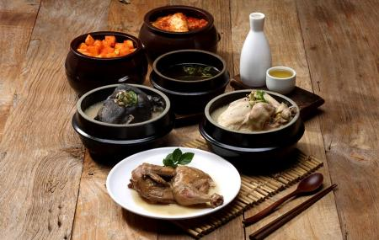
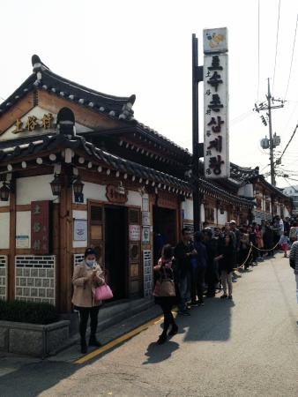
FOOD
Tosokchon Samgyetang
It was often visited by the late president Roh Moo-hyun.
The budget is 3000 pesos and because the restaurant offers cheap food, the students or tourists will really get the value for their money.
The menu consists of traditional korean food and this will really showcase their cuisine and how it is very unique compared to others.

Slide 8
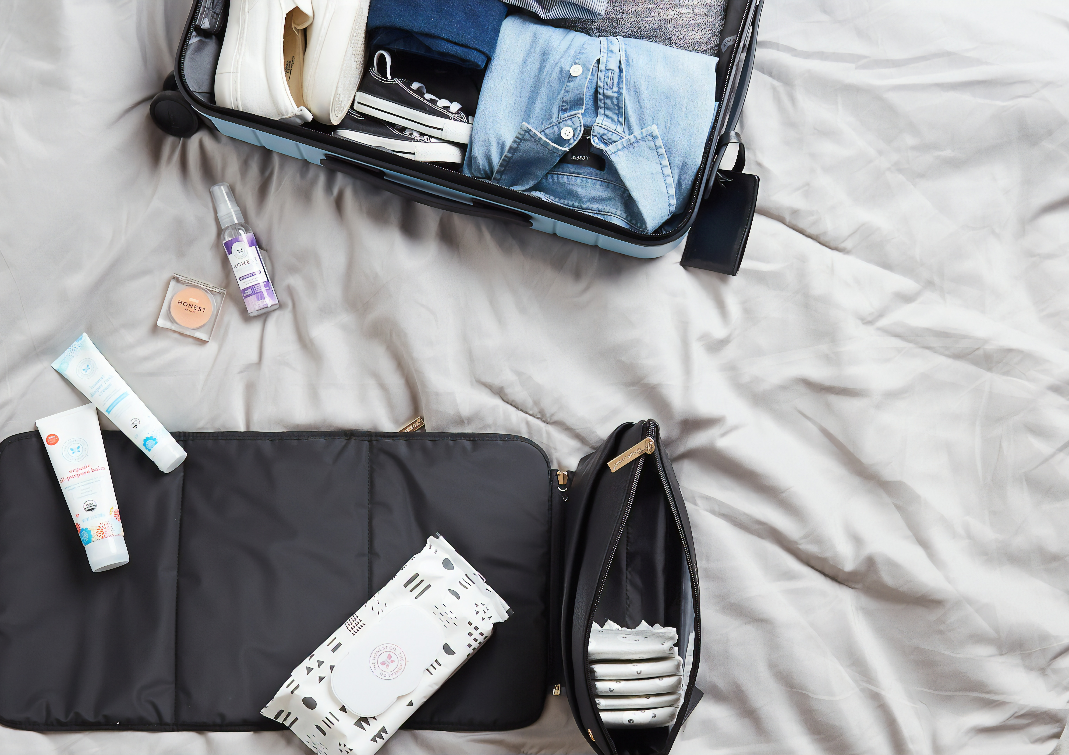
REMINDERS
To have and bring a passport
Extra money
Extra Clothes
Food & Water
Map or the pamphlet containing the activities that are scheduled for the day
*To be always polite and respectful

Slide 9
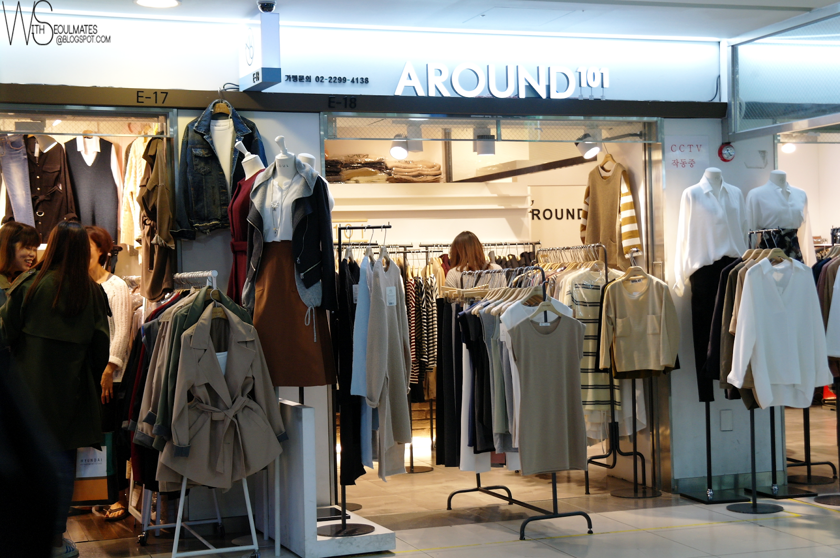
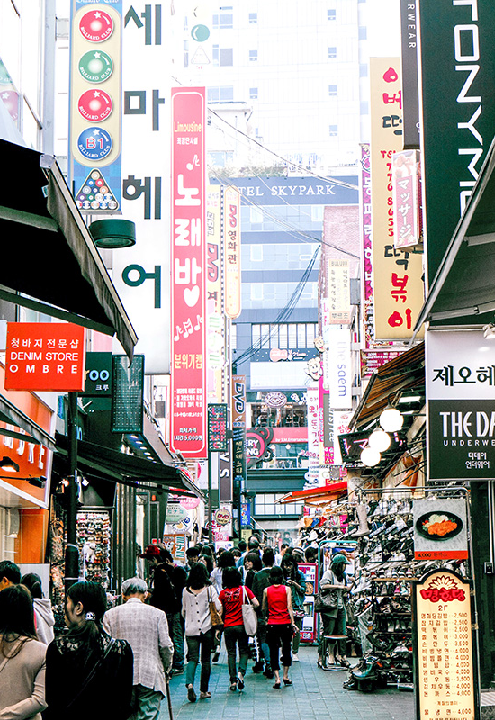
Other Information
Prices for clothes may vary in each stall. It's recommended to shop wisely by having a cheap budget to not lose track of how much you spent.
And to also be attentive of your belongings and surroundings

Slide 10

BUDGET
On average 1500 USD/75,877.50PHP per person is your budget. (Rates for kids may differ.)

Slide 11
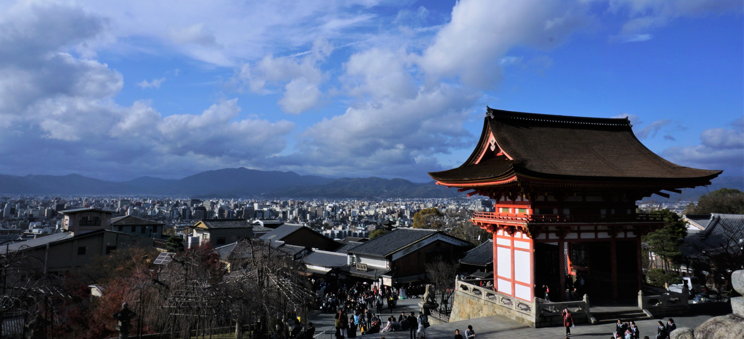
DESTINATION B – JAPAN; KYOTO
To experience Japanese and local culture and interact with local residents.

Slide 12
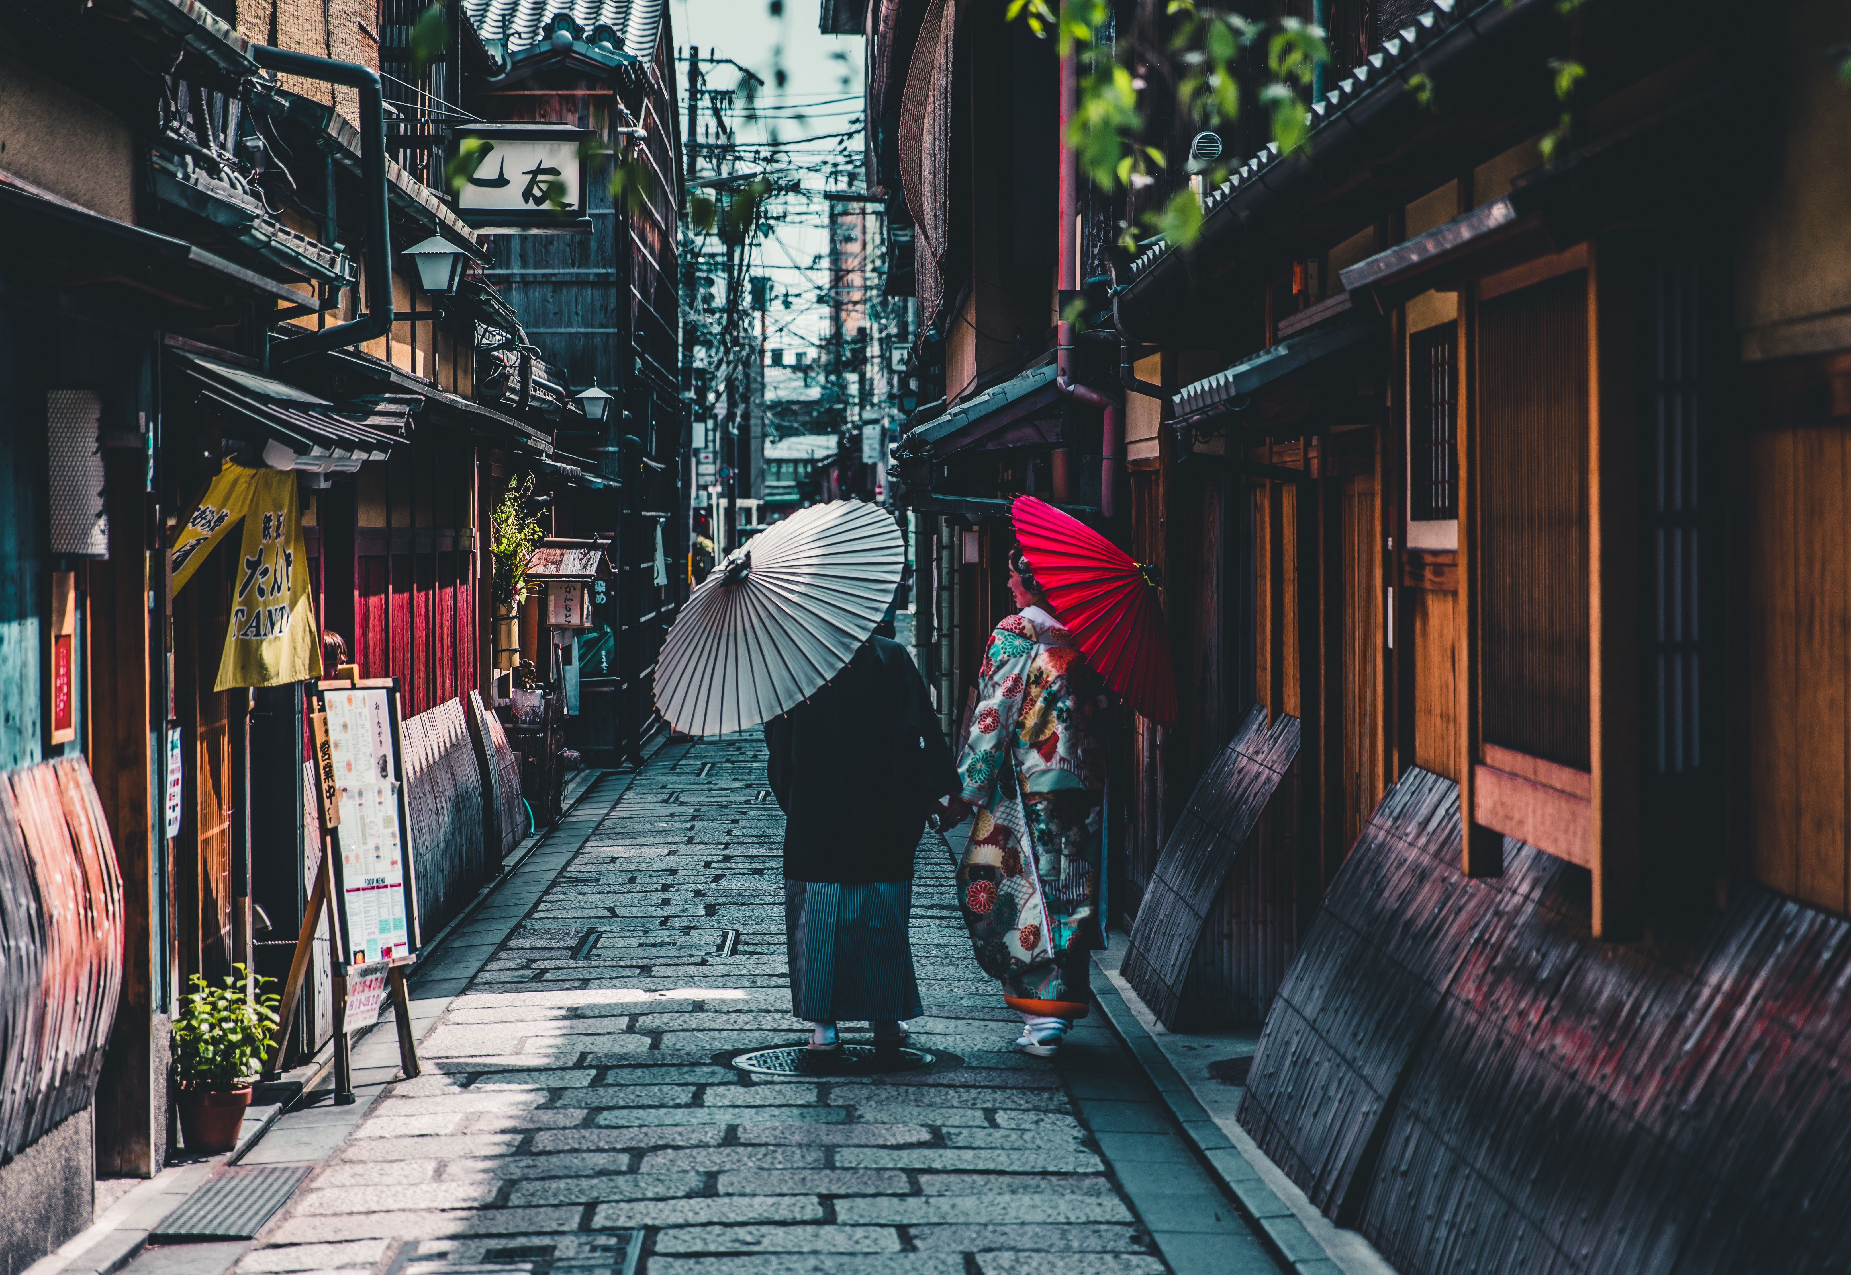
CITY TOUR
For travelling in Kyoto it takes a 2 day minimum trip, maximum it would take 5 days.
While also added two days to shop and for off-track and no guide exploring.
The First three days of the trip would be temple filled activities. Such as Fuschimi-Inari-Taisha Shrine with over 100 gates spread across the mountain and even Tenryu-ji Temple with one of the finest gardens in Kyoto and mountain views .
Days 2-5 will be filled with the showcase of japanese culture and what they do until now like Zen Meditation and having Tea Ceremony.

Slide 13
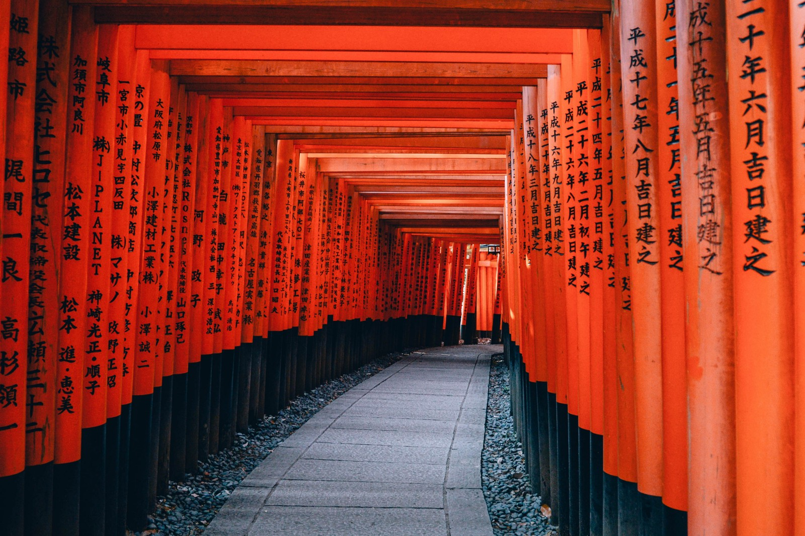
Fushimi-Inari-Taisha

Slide 14
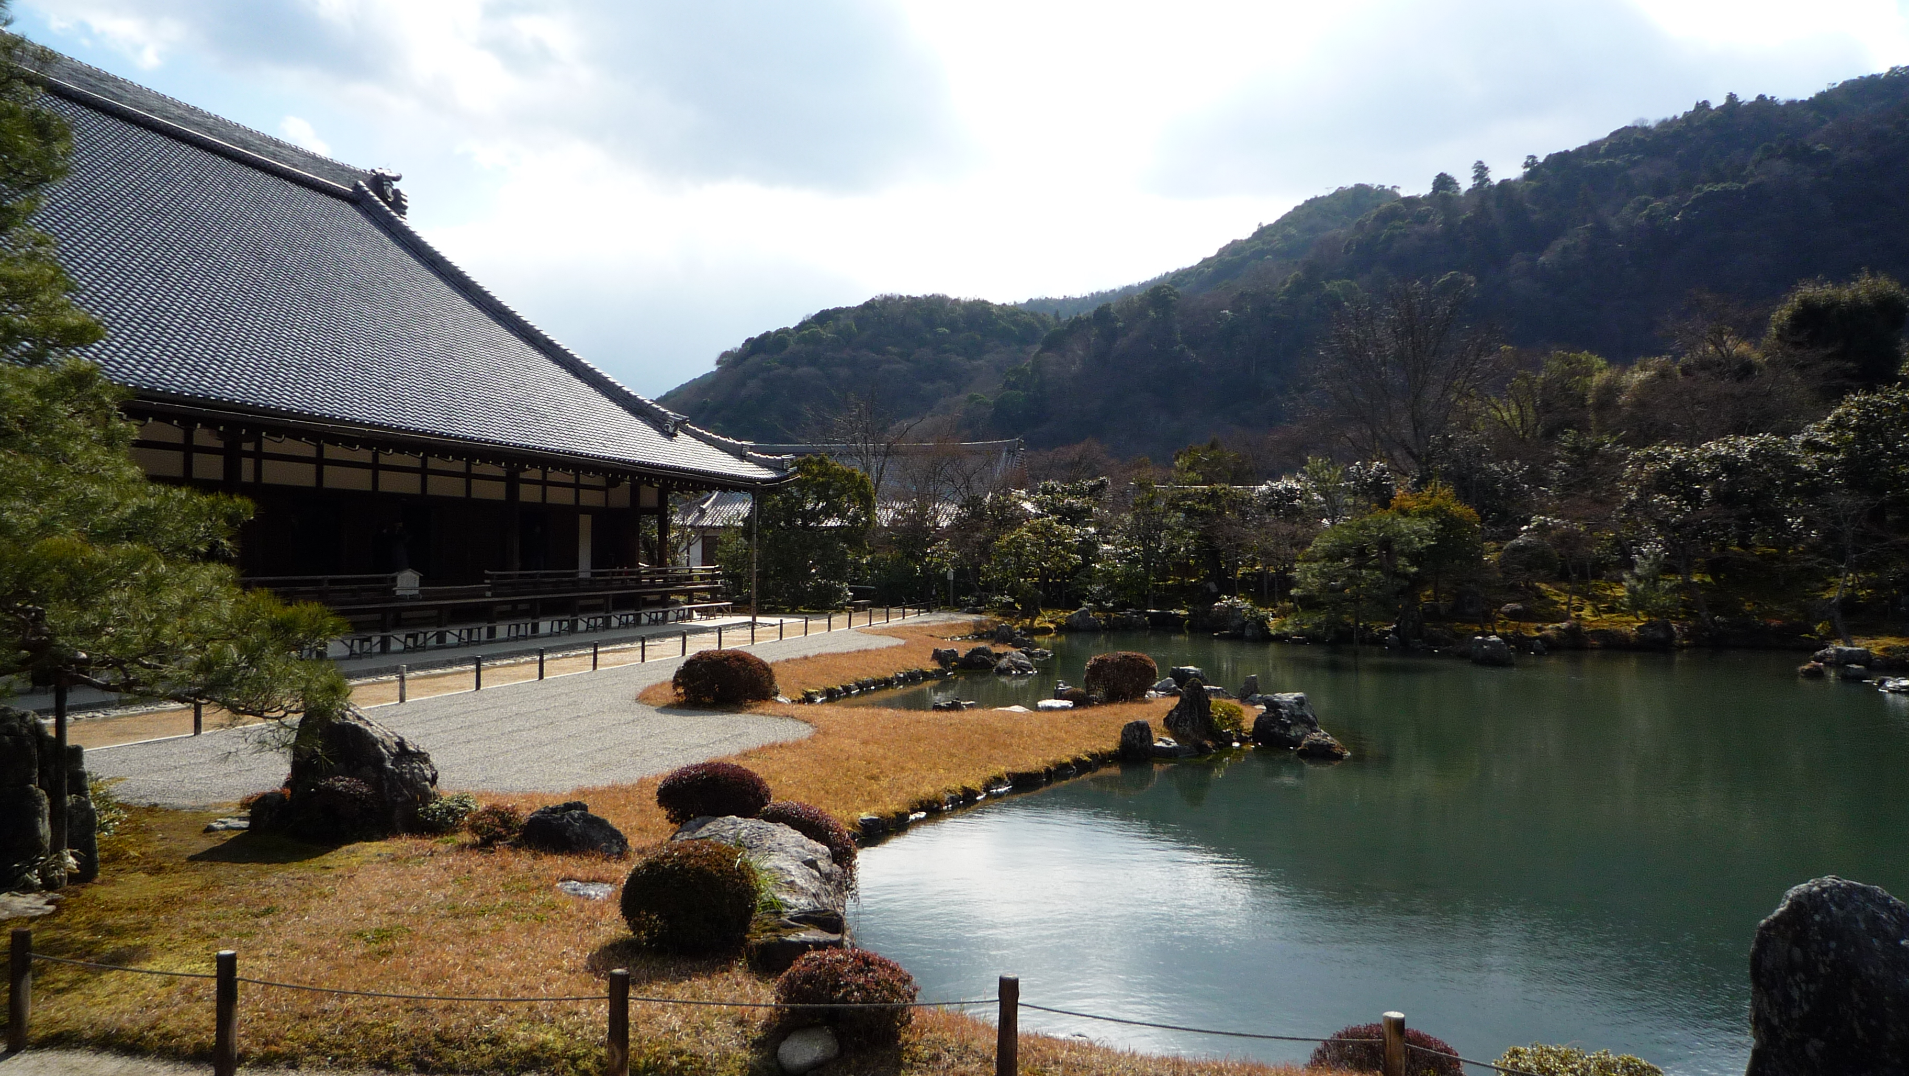
Fushimi-Inari-Taisha

Slide 15
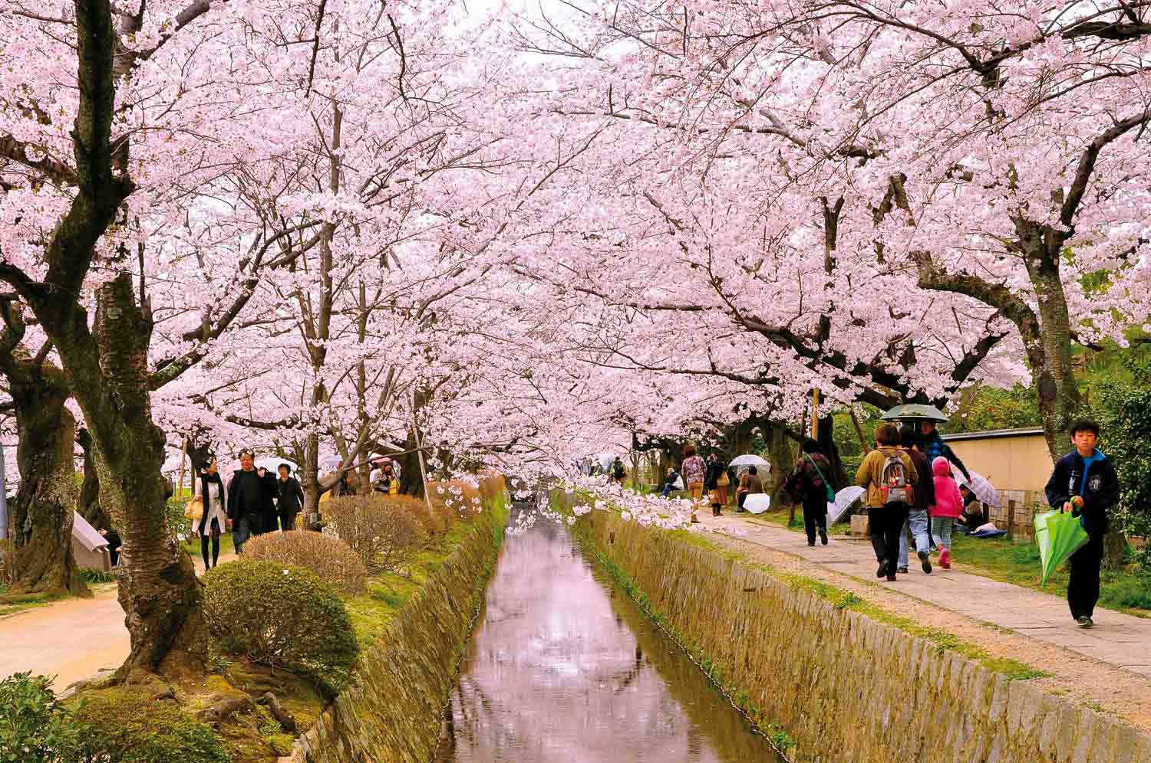
SPRING/AUTUMN
The best time to visit Kyoto is either spring or autumn, especially the cherry blossoms in the spring and fall foliage in the fall. The best length of visit in Kyoto is 2 full days because Kyoto is a fairly large city with many attractions.

Slide 16
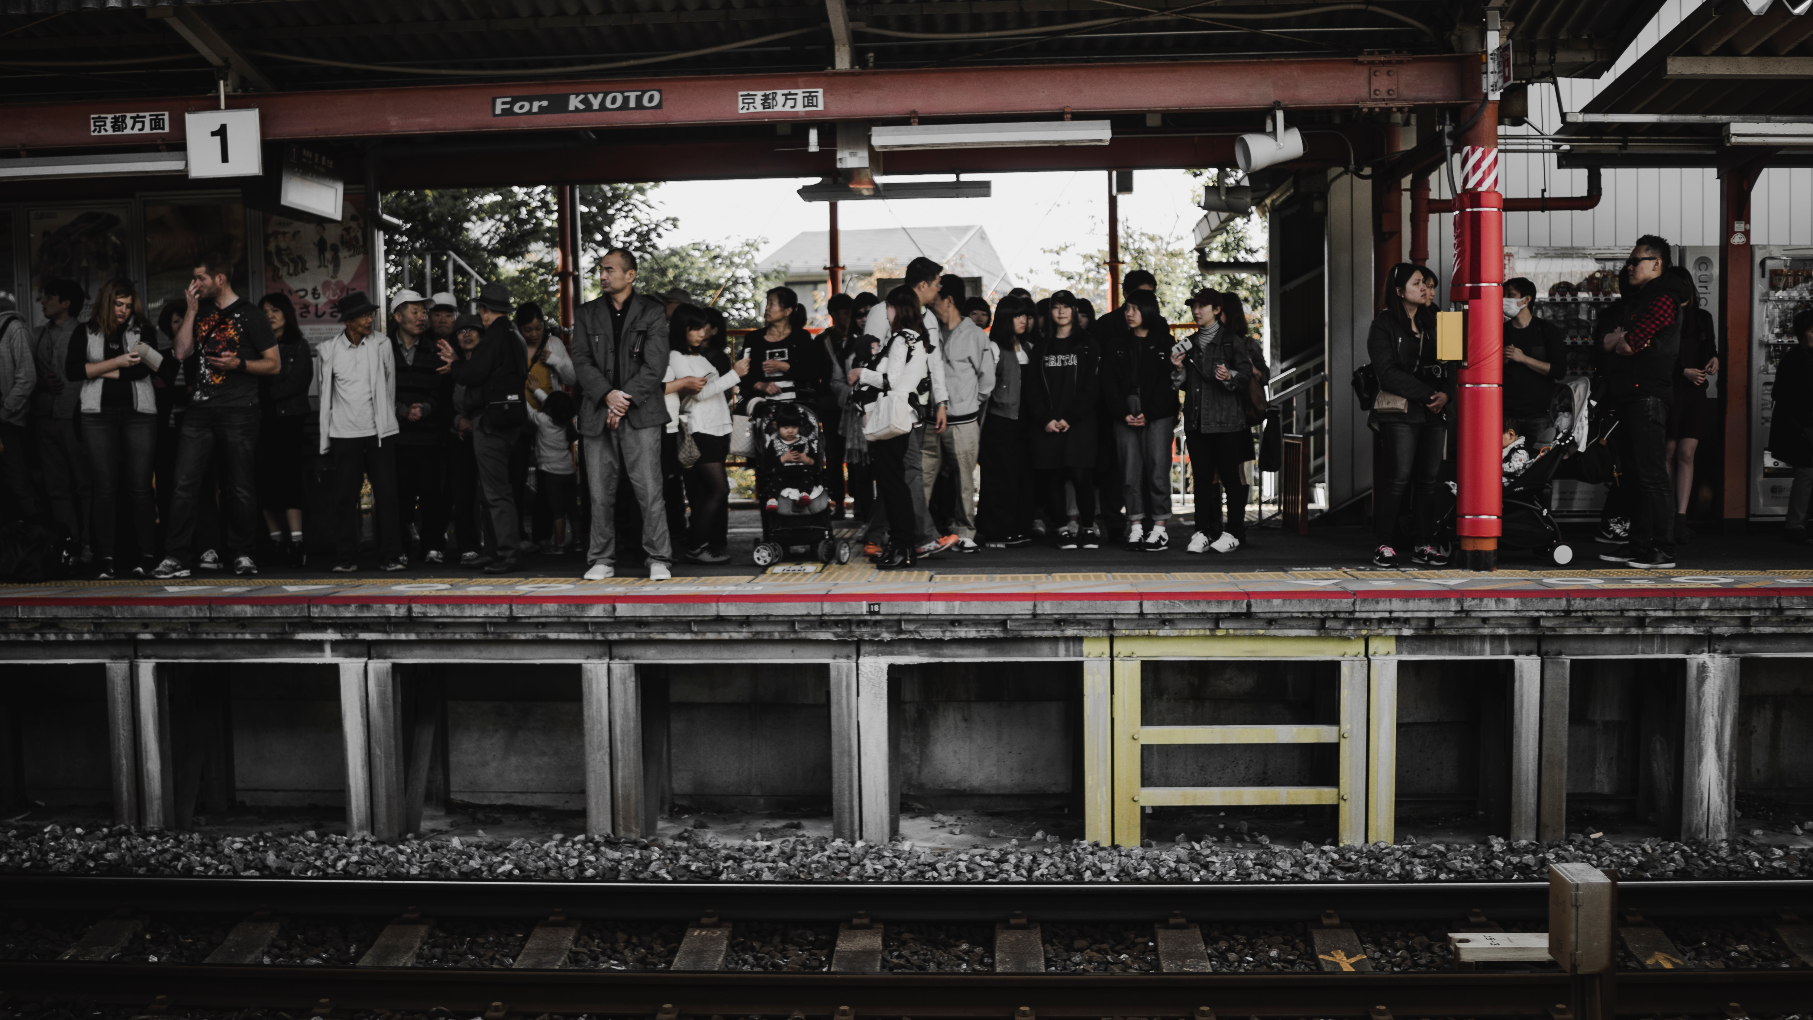
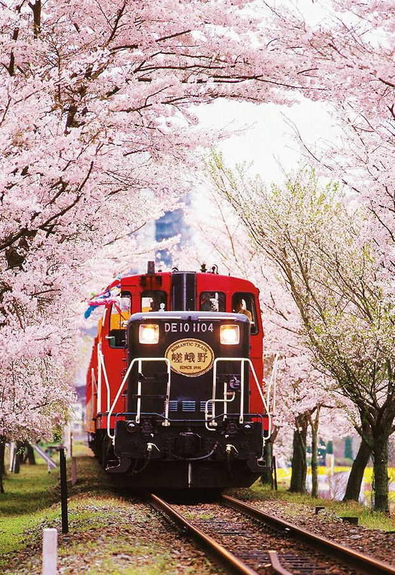
PUBLIC TRANSPORT
As ordinary as it sounds, public transport in Kyoto gives the most scenic views
The recommended way to go around Kyoto is to use public transportation. Which includes trains, buses, cars, and rental bicycles.
For One-day rental bicycles your budget would be 1000-1500 yen for regular bicycles. And 1700-2000 for electric bicycles.
For trains tours your budget can reach as 24,400 yen. Which takes you 1 place for 7 days travelling Tokyo to Kyoto. And for non-reserved seats fares will reach 13,320 yen and 14,000 for reserved ones.

Slide 17
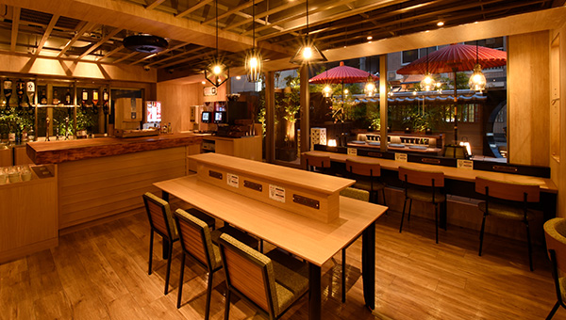
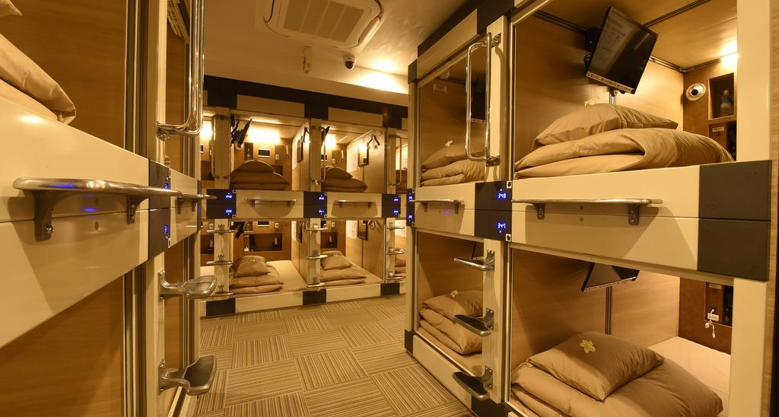
ACCOMODATION
For budget friendly and solo trips is the way to go. It is a capsule hotel good for sleeping at night and travelling again during the day. Packing light is a must if you stay here. It also has saunas, baths and comfortable and clean capsules for you to stay.
(For one adults capsules reach to 4848 Yen/ 2233.11 PHP)

Slide 18
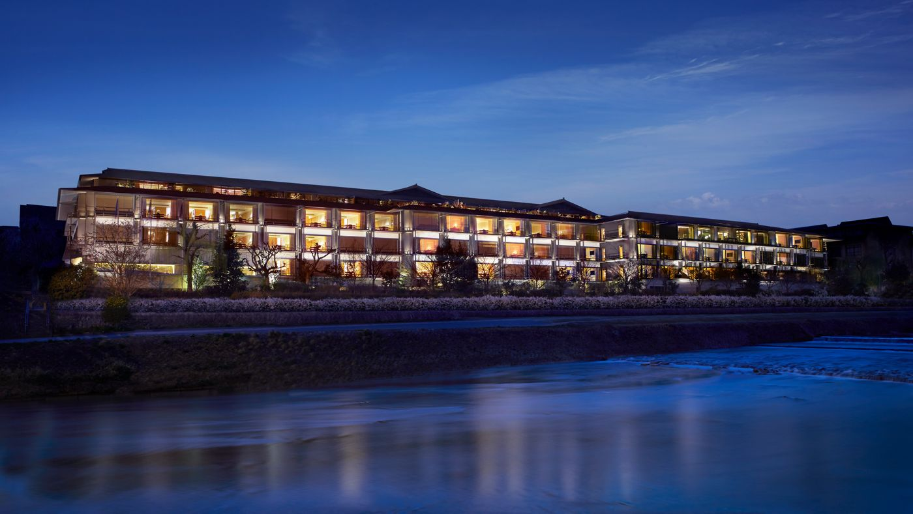
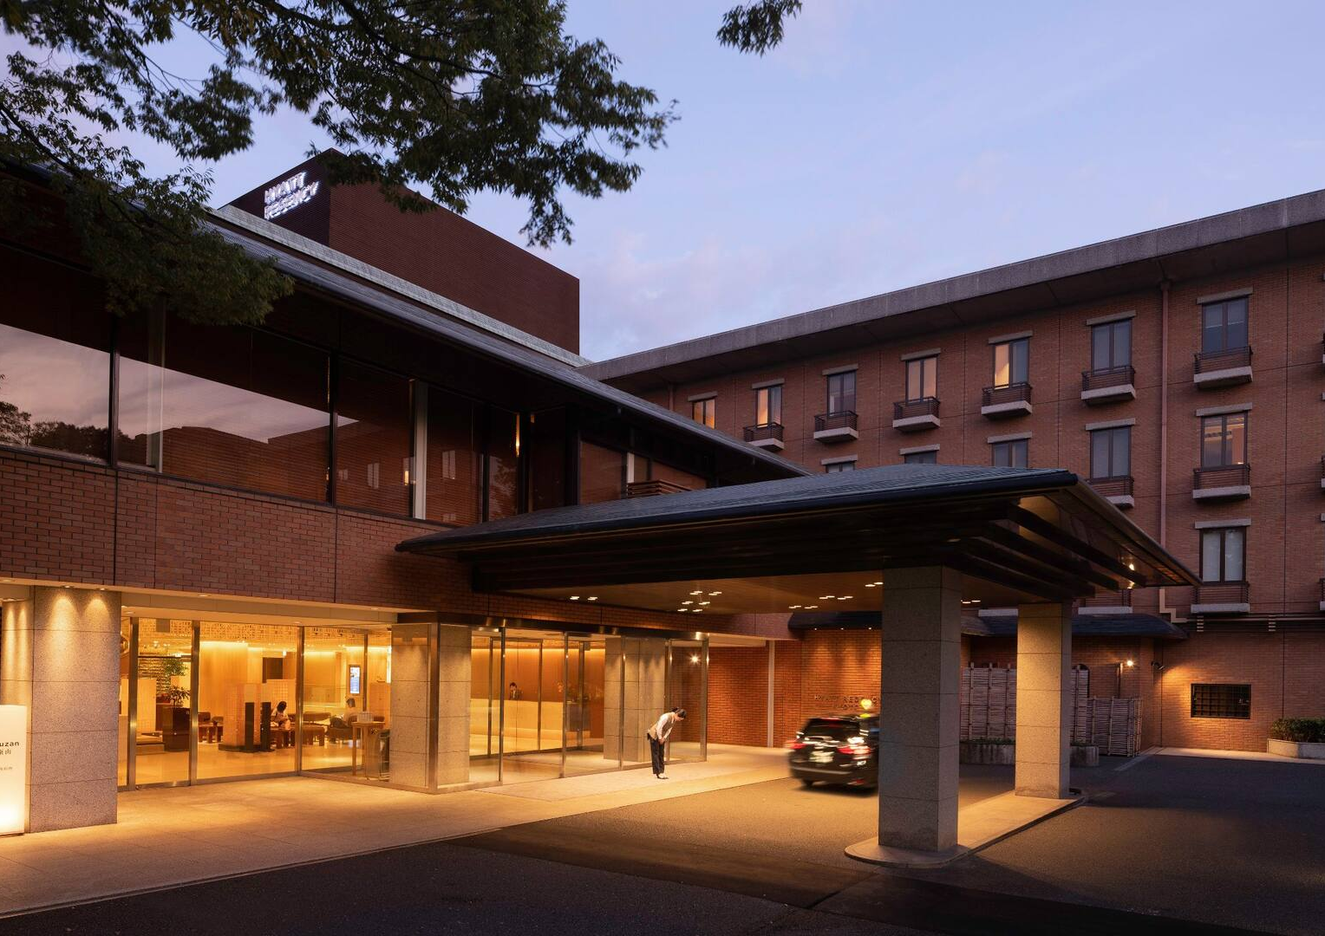
LUXURY
The Ritz-Carlton Kyoto, has spacious and beautiful rooms while also having a remarkable view on Higashiyama Mountains. Another is Hyatt Regency Kyoto which has lower rates but have great service and delicious restaurants. (For two adults budget reaches up to 94039 Yen/ 43316.62 PHP)

Slide 19
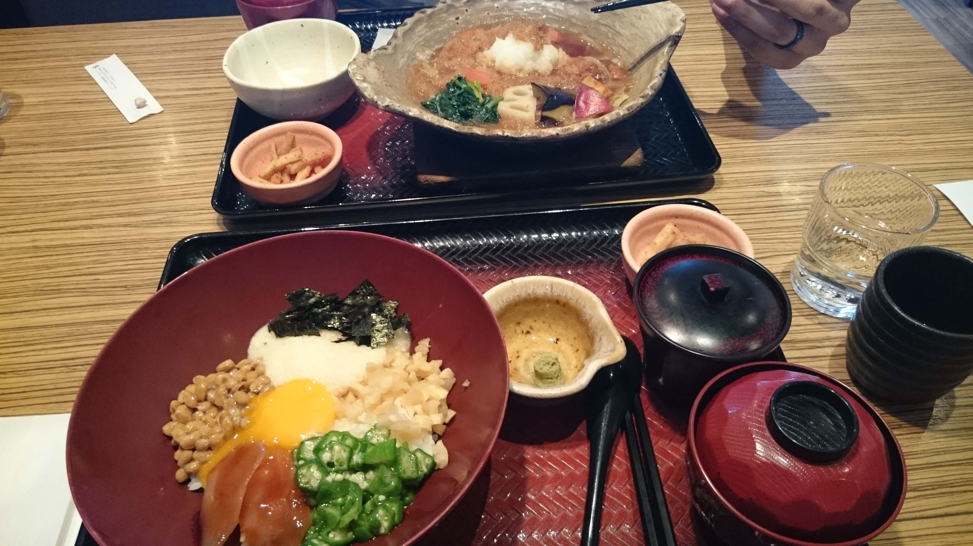
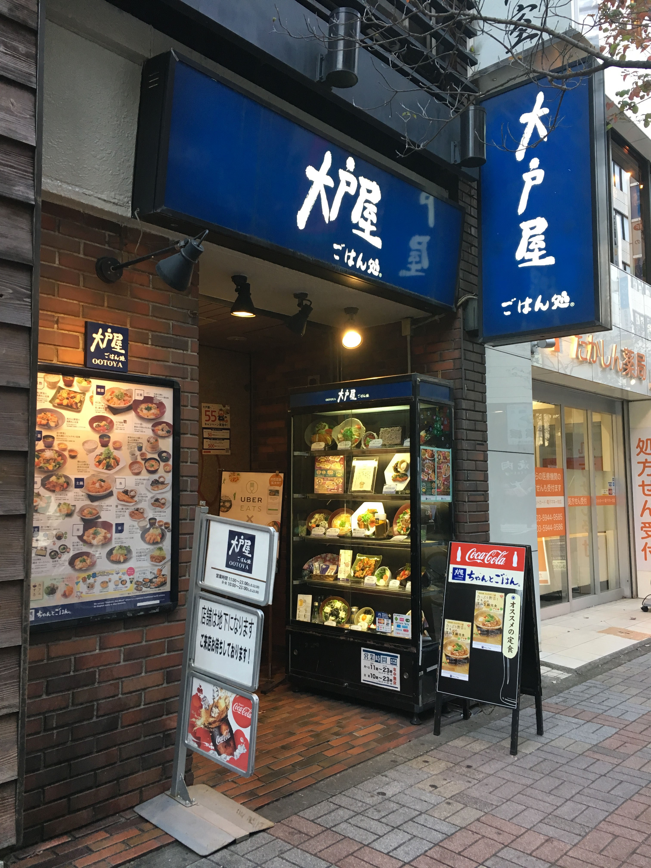
FOOD
Ramen Muraji is the place to go. It is budget friendly and a place that you cant go wrong with. (Bowls of ramen reach until 830 yen appx.)
For all around restaurants, Ootoya Gohan-dokoro, is a place one place to go. It is budget-friendly, casual, and healthy while also having easy translated english menus.

Slide 20
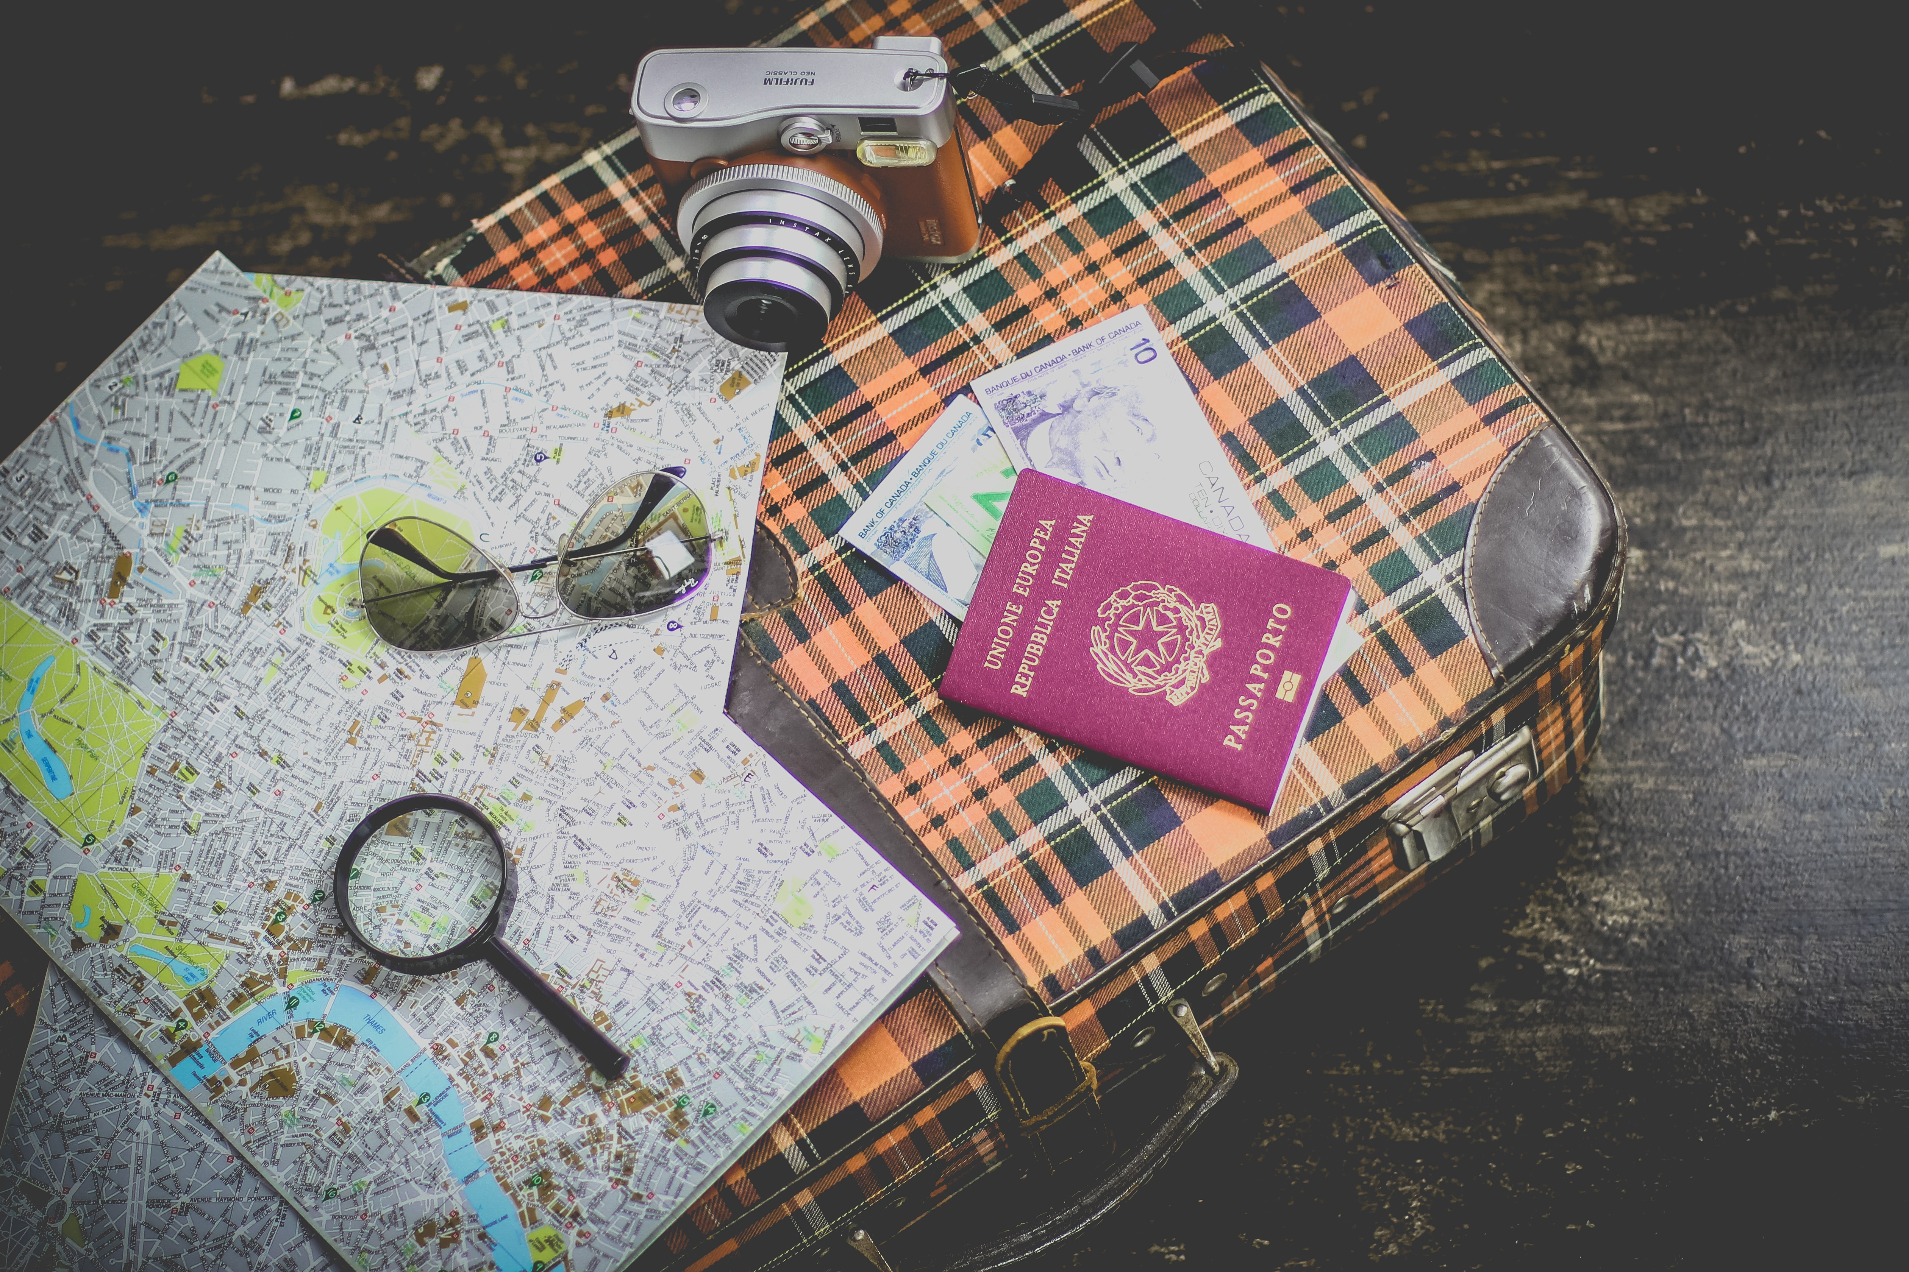
REMINDERS
Kyoto may look very pleasing but before you enter you must have a visa and have your passport at all times when you are there.
In Kyoto there are many temples which require a lot of endurance and water. So bring an electrified spirit and a lot of water.
Japan Rail pass is a must recommend since it takes you around japan within 7 days but having a time limit to each area which is one day.
Guides and maps are a must, Japan is very wide and large which may cause one person to get lost if they don't have one.

Slide 21
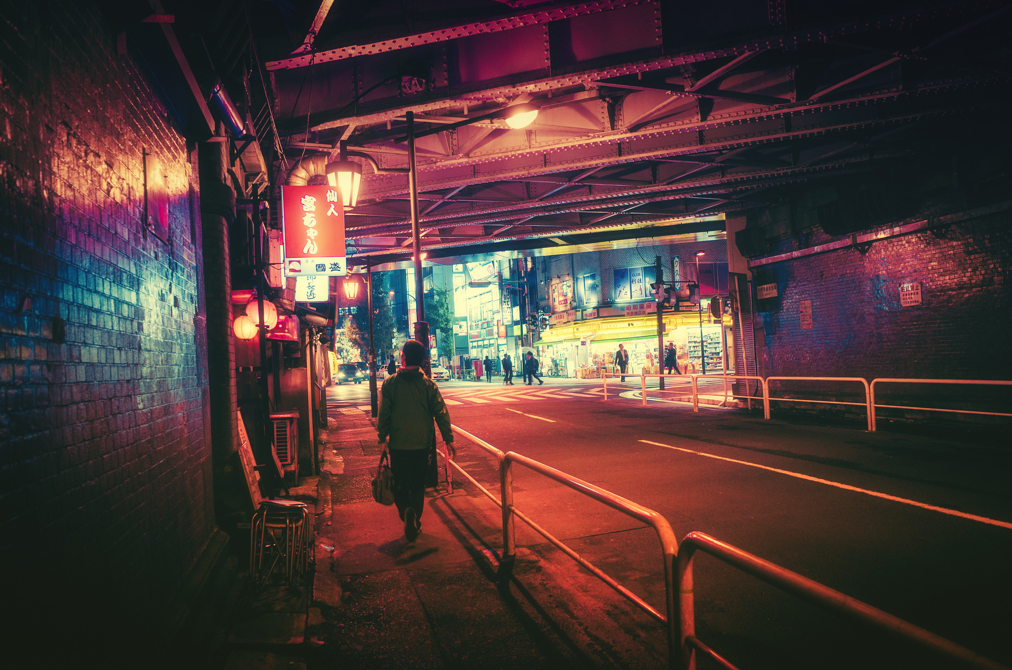
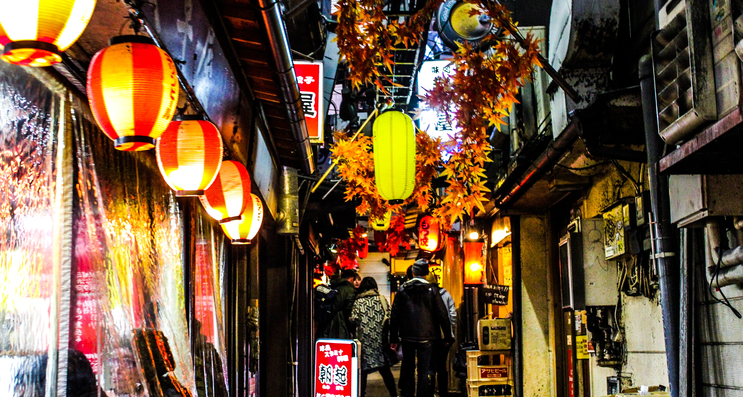
OTHER INFORMATION
To optionally have a Japan rail pass (for public transport)
To bring extra Cash/Credit
Have a copy of passport and cards
Maps and Guide bools
For more information: https://www.insidekyoto.com/packing-list-for-japan

Slide 22
BUDGET
Budget for one week in Japan your total budget is 1932 USD / 97691.58 PHP per person (Rates for kids may differ.)

Slide 23
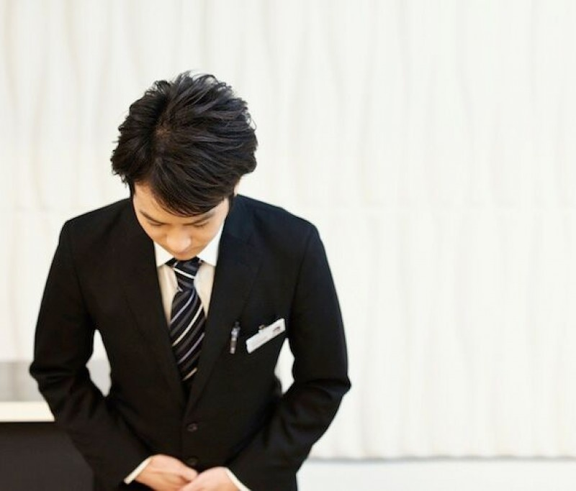
THANK YOU
S.T.E.M. – JUSTICE
Daniella Janabon
Sean Edillor
Manuel Pacia
Jeremie Cusi
John Paul Limpin
PHONE:
0915-496-8285
EMAIL:
smthsmth@bloomfield.edu.ph

